Slide 1
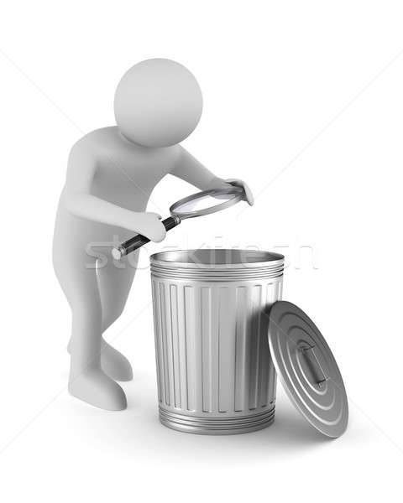
Lecture 1 The emergence of the subject of electrochemistry of active metals The Challenge by Waste
Fyodor Malchik

Slide 2
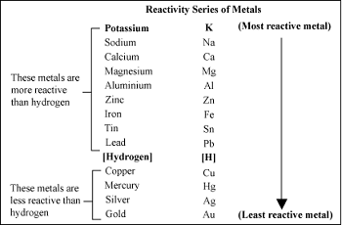
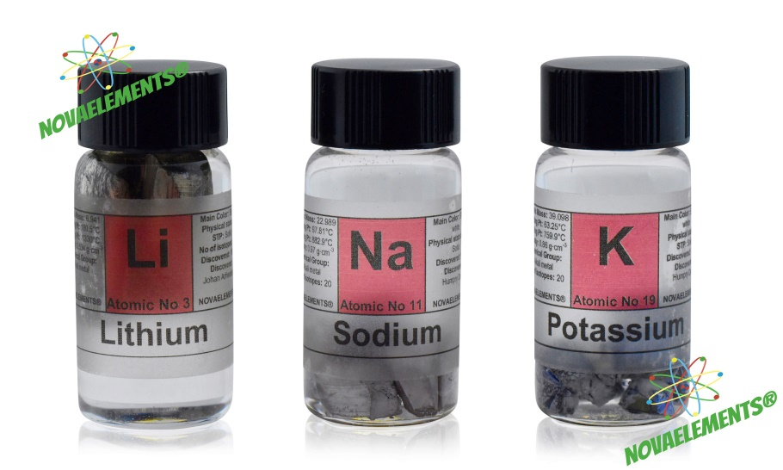
The study of the electrochemistry of active metals has gained significant attention and prominence due to its relevance in various advanced technologies. Active metals, such as lithium, sodium, and potassium, have unique electrochemical properties, making them essential components in energy storage systems, such as rechargeable batteries. Here are a few key points highlighting the emergence of this subject:

Slide 3
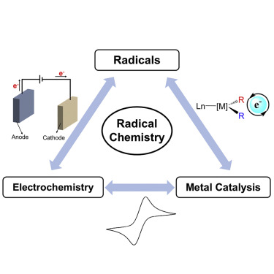
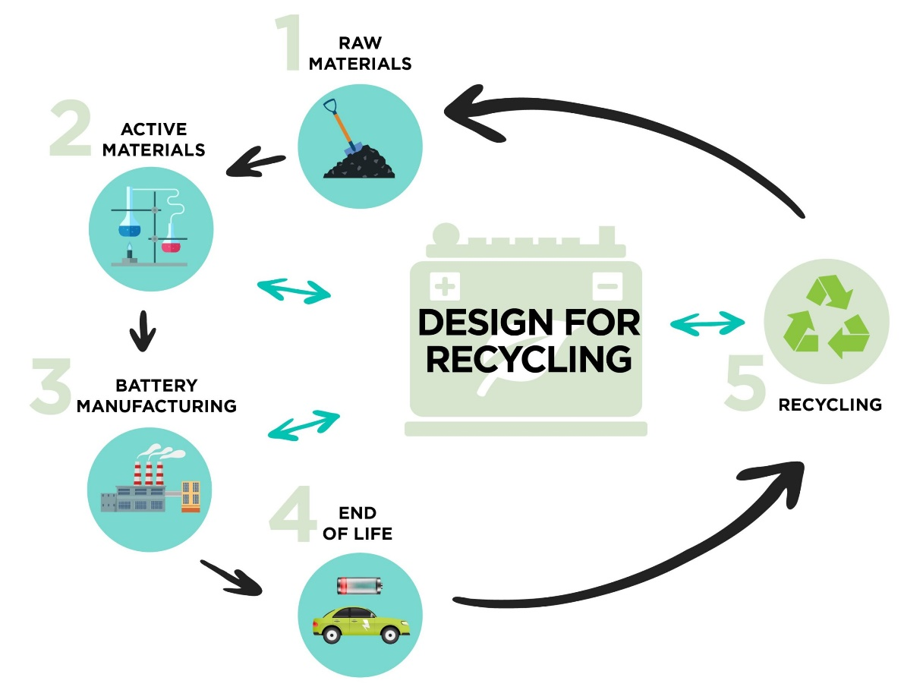
Usually available solutions
are NOT SOLUTIONS

Slide 4
County data for 2013-2023
2013: 335.000 tones dry waste
481 kg/person/year: - 86% urban → 615 kg/person/year
- 14% rural → 209 kg/person/year
16% treated / processed
70 waste deposits → to close / modernize
CIS norms ➔ need of LOCAL STRATEGY

Slide 5
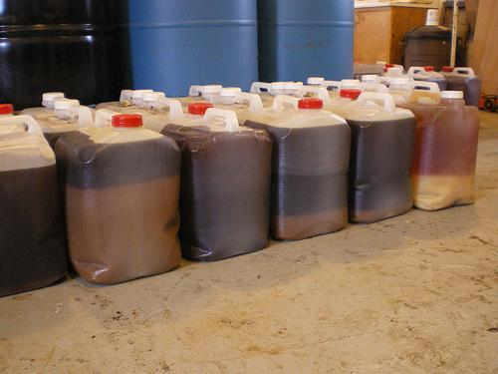
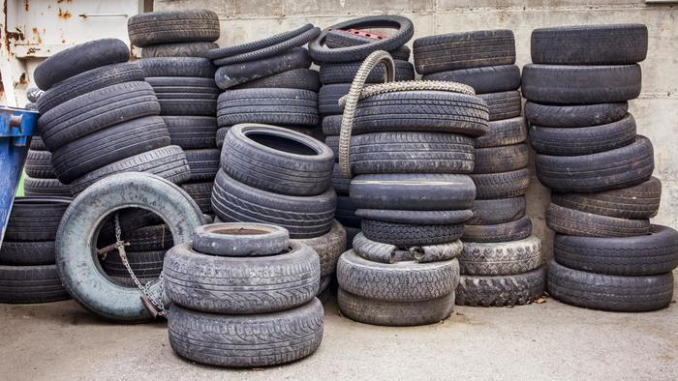
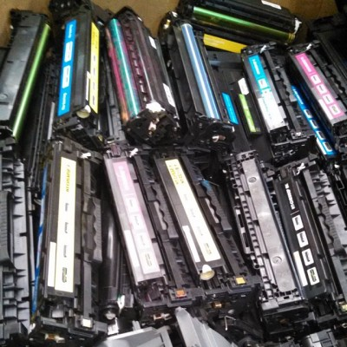
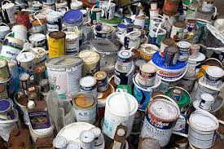
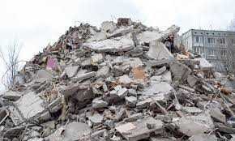
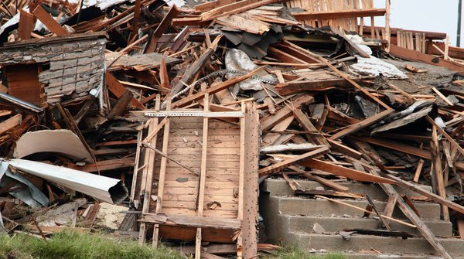
“Special” categories

Slide 6
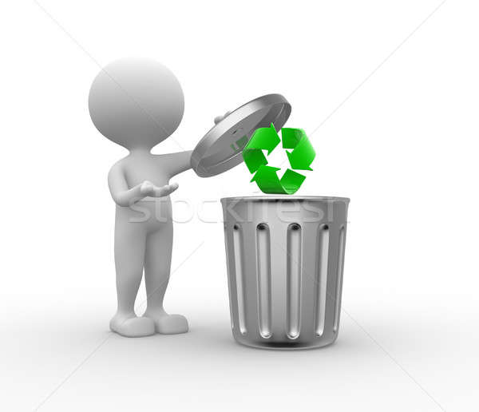
Some concluding thoughts
Situation of Cluj-Napoca city – beginnings
Personal contribution
Contribution of society / authorities
+ RE-Design

